Slide 1

SQL INJECTION
Submitted By:
Karina Paudel Roll no-13
Preeti Gurung Roll no-22

Slide 2
SQL Injection is a type of cyber attack where malicious SQL code is injected into queries to manipulate databases and gain unauthorized access to sensitive information.
Basically, it is one of the most common web hacking techniques that might destroy your database.
Attackers can extract sensitive information, modify database data, execute administration operations on the database (such as shutdown DBMS), recover the content of a given file present on the DBMS file system, etc.

Slide 3
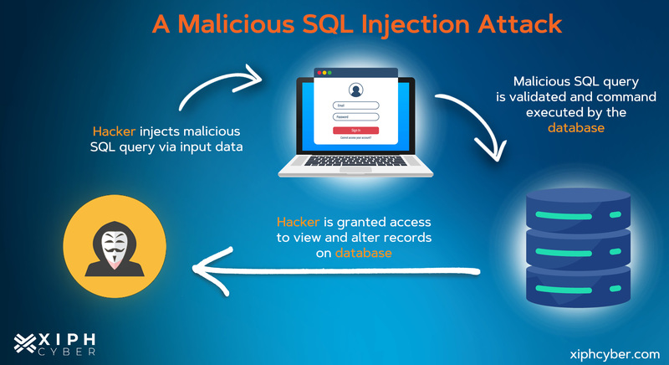

Slide 4
How SQL Injection Works
Vulnerable Application
An application that does not properly sanitize user input is vulnerable to SQL injection attacks.
Malicious Query Injection
The attacker inserts malicious SQL code into the application's query, tricking the database into executing the malicious code.
Data Extraction
The attacker can then extract sensitive data from the database, such as user credentials or financial information.

Slide 5
SQL Injection Types
There are different types of SQL injection attacks:
In-band SQL Injection: Directly sends malicious SQL queries through the web app to extract or modify data. Attacker enters ' OR 1=1; –’ into a login form to bypass authentication, as ‘1=1’ is always true.
Error-based SQL Injection: Uses application error messages to extract confidential data or alter the database.
Out-of-band SQL Injection: Attackers use a separate communication channel to steal sensitive data from the database.

Slide 6
Blind SQL Injection: Attackers send SQL queries and observe delays or responses to confirm successful injection..Example: Inputting ‘AND SLEEP(5); -- delays response by 5 seconds.
Inference-based SQL Injection: Attackers use queries that consistently return results regardless of input to access confidential data.

Slide 7
Examples
SQL Injection Based on 1=1 is Always True
User Input: 105 OR 1=1
SQL Query: SELECT * FROM Users WHERE UserId = 105 OR 1=1;
Effect: Returns all rows from the Users table because 1=1 is always true.
SQL Injection Based on ""="" is Always True
User Input: Username: " " or "=", Password: " " or "="
SQL Query: SELECT * FROM Users WHERE Name ="" or ""="" AND Pass ="" or ""="";
Effect: Logs in without a valid username/password because ""="" is always true, the condition bypasses the real username and password check.

Slide 8
3. SQL Injection Based on Batched SQL Statements
User Input: 105; DROP TABLE Suppliers
Query: SELECT * FROM Users WHERE UserId = 105; DROP TABLE Suppliers;
Effect: Deletes the Suppliers table after selecting from Users.
The attacker’s input tricks the system into running additional harmful commands.

Slide 9

Preventing SQL Injection Attacks
Input Sanitization
Properly sanitize and validate all user input before using it in SQL queries.
Prepared Statements
Use parameterized queries and prepared statements to separate the SQL code from the user input.
Least Privilege
Grant the minimum necessary permissions to database users to limit the damage of a successful attack.
Web Application Firewalls
Implement a web application firewall to detect and block SQL injection attempts.

